Slide 1

SPEED BREAKER WARNING SYSTEM
DONE BY:
JEEVESHWARAN.J-811721243020
PRITESH.S-811721243040
PRIYAGANTH.K-811721243041
SANTHOSH.H.S-811721243048
Project Guide: Mrs S.GEETHA M.E.,

Slide 2
OBJECTIVES
The Speed-Breaker Warning System aims to provide advanced warning to drivers approaching speed breakers, thereby enhancing road safety.
The system utilizes sensors and microcontroller-based technology to detect the presence of a vehicle and the upcoming speed breaker
Road safety is a critical concern, especially in areas where speed breakers are installed to regulate vehicle speeds.
However, accidents still occur due to drivers failing to notice speed breakers in time, particularly in low visibility conditions or at night.

Slide 3
EXISTING SYSTEM
Ultrasonic sensors emit high-frequency sound waves and measure the time it takes for the waves to bounce back after hitting an object.
These sensors can be installed on vehicles to detect changes in road surface elevation, indicating the presence of a speed breaker ahead.
Cameras installed on vehicles or roadside infrastructure can capture images of the road surface.
Image processing algorithms to detect speed breakers based on their distinct visual characteristics, such as shape and color

Slide 4
PROPOSED SYSTEM
The proposed In-Car Speed Breaker Detection System aims to enhance road safety by providing real-time alerts to drivers when approaching speed breakers.
By leveraging sensor technology and advanced signal processing algorithms, this system detects speed breakers ahead and alerts the driver.
A microcontroller unit processes the sensor data in real-time and executes the speed breaker detection algorithm.
The MCU is responsible for analyzing sensor readings, determining the presence of speed breakers, and triggering alerts when necessary.

Slide 5
LITERATURE SURVEY
S.NO | TITLE | YEAR OF PUBLICATION | AUTHORS | ALGORITHMS USED | MERITS | DEMERITS
1. | A Review on Vehicle Speed Detection using Image Processing | November 2017 | Balasubramani Ramasamy | Matlab algorithm | Binary image generation | It is does not work in low visibility
2. | Automatic Pothole and Speed Breaker Detection using Android System | 2016 | Hamshan Khan , Vinay Rishiwal | potholes | Feature selection | Less accuracy

Slide 6
LITERATURE SURVEY
S.NO | TITLE | YEAR OF PUBLICATION | AUTHORS | ALGORITHMS USED | MERITS | DEMERITS
3. | Intelligent speed breaker system design for vehicles using Internet of Things | 2023 | Ishika Chandra, Kamlesh Pandey, S.K. Sinha | Lidar algorithm | Long Range | It take Process time
4. | Federated learning for accurate detection of speed breakers on the road | 2020 | md abdur Razzaque,Md. Mamunurahman, md. Rashfit ahmed rahi | Federated learning | Accuracy high | Does not work in rainy season

Slide 7
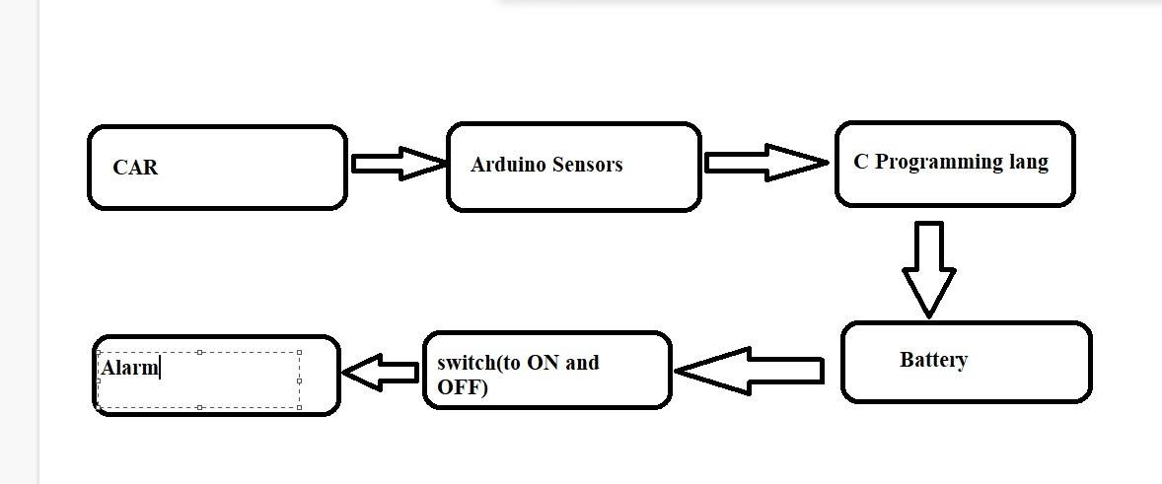
SYSTEM ARCHITECHTURE

Slide 8
SYSTEM REQUIREMENTS
SOFTWARE REQUIREMENTS
Operating system: Windows OS.
Algorithm for Speed Breaker Detection.
Decision-Making Logic.
Integration with Vehicle Systems.
HARDWARE REQUIREMENTS
Sensor: LIDAR (Light Detection and Ranging).
Microcontroller.
Power Supply.
Mounting Hardware.
Alert System.

Slide 9
MODULES
LIDAR SENSOR MODULE
MICROCONTROLLER MODULE
COMMUNICATION MODULE
WARNING SYSTEM MODULE

Slide 10
LIDAR SENSOR MODULE:
LIDAR SENSOR MODULE:
The LiDAR Sensor Module is responsible for detecting the presence of speed breakers and approaching vehicles by measuring distances accurately. It plays a crucial role in the speed breaker early warning system by providing precise distance measurements to the microcontroller for further processing.
FUNCTIONS:
LiDAR Sensor: A laser-based sensor capable of measuring distances with high accuracy. Examples include the Garmin LIDAR-Lite v3 or RPLIDAR A1.

Slide 11
LIDAR SENSOR MODULE:
Microcontroller: A microcontroller like Arduino, ESP32, or Raspberry Pi that interfaces with the LiDAR sensor and processes its data.
Power Supply: A stable power source, typically 5V DC, to power the LiDAR sensor and the microcontroller.
Wiring and Connectors: Cables and connectors to establish electrical connections between the sensor, microcontroller, and power supply.

Slide 12
MICROCONTROLLER MODULE:
The microcontroller module is a crucial part of the speed breaker early warning system, responsible for processing data from sensors, making decisions, and coordinating communication with other modules.
FUNCTIONS:
Sensor Data Processing: Collects data from the LiDAR sensor, which measures distances to detect approaching vehicles and speed breakers. Converts raw sensor data into meaningful information (e.g., distance in centimeters).
Decision Making: Implements logic to determine when a vehicle is approaching a speed breaker . Sets thresholds and conditions to trigger alerts (e.g., if the distance is less than a certain value).

Slide 13
MICROCONTROLLER MODULE:
Communication: Sends processed data and alerts to the communication module. Receives commands or updates from a central server or other modules.
Control Outputs: Controls warning systems like LED displays or buzzers to alert drivers. Can interface with other actuators if needed.
Power Management: Manages power consumption to ensure efficient operation, especially in battery-powered setups.

Slide 14
COMMUNICATION MODULE:
The communication module is a critical component of the speed breaker early warning system, responsible for transmitting data between the sensor nodes and the vehicles or a central server.
Transmit Data: Send sensor data and alerts from the microcontroller to a central server, cloud platform, or directly to vehicles.
Receive Data: Receive commands, configurations, and updates from a central server or control unit. Ensure Real-Time Communication: Maintain low-latency communication to ensure timely alerts for approaching vehicles.

Slide 15
WARNING SYSTEM MODULE:
Detection and Notification: Receives signals from the microcontroller indicating the detection of a vehicle approaching a speed breaker. Processes these signals to determine the appropriate warning to be issued.
Auditory Alerts: Activates buzzers or alarms to produce sound alerts when a vehicle is approaching the speed breaker . The sound intensity and pattern can be varied based on proximity and speed of the vehicle.

Slide 16
ADVANTAGE:
Low Power Consumption: Ultrasonic sensors typically have low power requirements, making them suitable for use in battery-powered or energy-efficient vehicle systems.
Accuracy: Ultrasonic sensors provide precise distance measurements, allowing for accurate detection of speed breakers regardless of their size or shape.
Low Power Consumption: Ultrasonic sensors typically have low power requirements, making them suitable for use in battery-powered or energy-efficient vehicle systems.
Cost-Effectiveness: Ultrasonic sensors are often relatively inexpensive compared to other detection technologies, making them a cost-effective solution for speed breaker detection systems.
Fast Response Time: Ultrasonic sensors typically have fast response times, enabling quick detection of speed breakers and providing drivers with timely warnings.

Slide 17
APPLICATION:
Low Power Consumption: Ultrasonic sensors typically have low power requirements, making them suitable for use in battery-powered or energy-efficient vehicle systems.
Emergency Response: IoT-enabled speed breaker detection systems can alert emergency services to potential road hazards, enabling faster response times in the event of accidents or emergencies.
Driver Assistance: IoT devices installed in vehicles can detect speed breakers ahead and alert drivers through visual or auditory signals, helping them adjust their speed accordingly to ensure safety.
Fast Response Time: Ultrasonic sensors typically have fast response times, enabling quick detection of speed breakers and providing drivers with timely warnings.

Slide 18
CONCLUSION:
In conclusion, the implementation of a speed breaker detection system is crucial for enhancing the safety of road users and ensuring smooth traffic flow.
By detecting speed breakers in advance, drivers are able to slow down and navigate these obstacles safely, reducing the risk of accidents and damage to vehicles.
This technology also helps to improve overall road conditions by alerting authorities to the presence of poorly marked or hidden speed breakers that may pose a threat to drivers.
Overall, speed breaker detection systems play a vital role in promoting road safety and creating a more efficient and secure driving environment for all.

Slide 19
REFERENCES:
1. Abhishek Sehgal, T. Balachander, Navaneetha Varier: "Smart Speed breaker system Using Internet of Things"
2. Partha Pratim Ray: "A survey of IoT cloud platforms"
3. M.V.K. Kiran et al.: "An early detection-warning system to identify speed breakers and bumpy roads using sensors in smartphones"
4. B.S. Nagesh, V.K. Reddy: "Smart Phone Based Speed Breaker Early Warning System"

Slide 20




